Slide 1
Internet Index Group KWIC Project www.utdallas.edu/~mrl081000/
Group Members:
Matt Lautz
Dan Modesto
Rizwan Noorani
Seyi Ogunsemi
Gowtham Sivagnanam

Slide 2
KWIC Project Management Approach
Goal: Good architecture and implementation prior to deadline.
Plan:
Set timelines for milestones.
Determine progress through docs, diagrams, and implementation status.
Architectural decisions are made as a group.
Non-functional reqs are prioritized to give rise to the detail design.
Group priorities will shift according to the progress of each milestone.

Slide 3
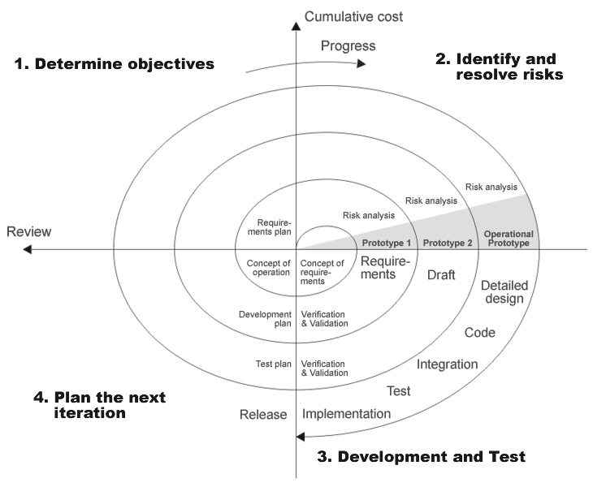
KWIC Project Process Model

Slide 4
KWIC Project Priority of NFR
Understandability
Performance
Responsive
Reusability
Enhance ability
Adaptability
Portability
User Friendly

Slide 5
KWIC Project Non-Functional Reqs
Understandability
Performance
Responsive
-
+
-
+
-
+
Abstraction
Time
Time
Brute Force
Space
Space
Max Cohesion
Use Merge Sort
Threading
Reusability
Enhance ability
Adaptability
Portability
User Friendly
-
+
-
+
-
+
-
-
+
Procedural
OOP
C++
Obj. C
Java

Slide 6
ADT Architecture
Legend
Instantiation:
Controller Component
Explicit Invocation:
Controller
Input Component
Shifter Component
Alphabetizer Component
Merge Component
Output Component
Set Data
Shift
Sort
Set Data
Save Original
Line
Process Data
Process Data
Merge
Output Lines
Process Data
Output Data
Process Data
Get Data
Output Data
Output Data

Slide 7
KWIC Project Class Diagram

Slide 8
KWIC Project Work Completed:
Created Software Project Management Plan
Finalized Software Requirements
Created Iterative Design
Created Iterative Implementation

Slide 9
KWIC Project Work Remaining:
Finalize Software Project Management Plan
Finalize Software Design Documentation
Finalize Software Test Documentation
Complete Implementation

Slide 10
KWIC Project Q&A

